Slide 1
IEEE Schematic Design
Will Fehrnstrom, Ryan Nemiroff, Kevin Zhang, Amit Golan

Slide 2
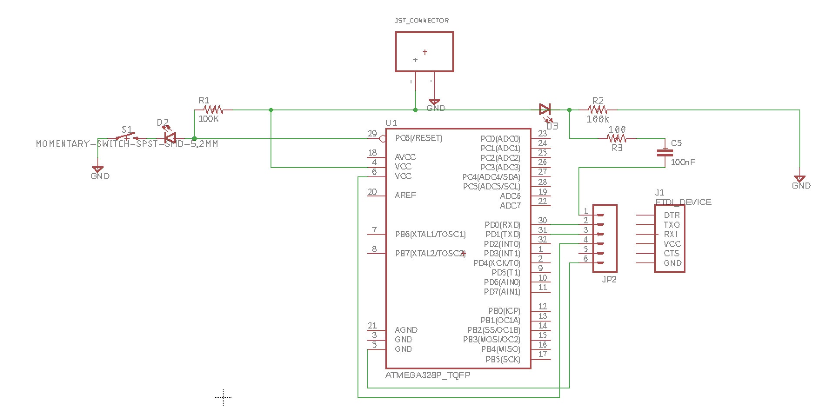
RESET/FTDI

Slide 3
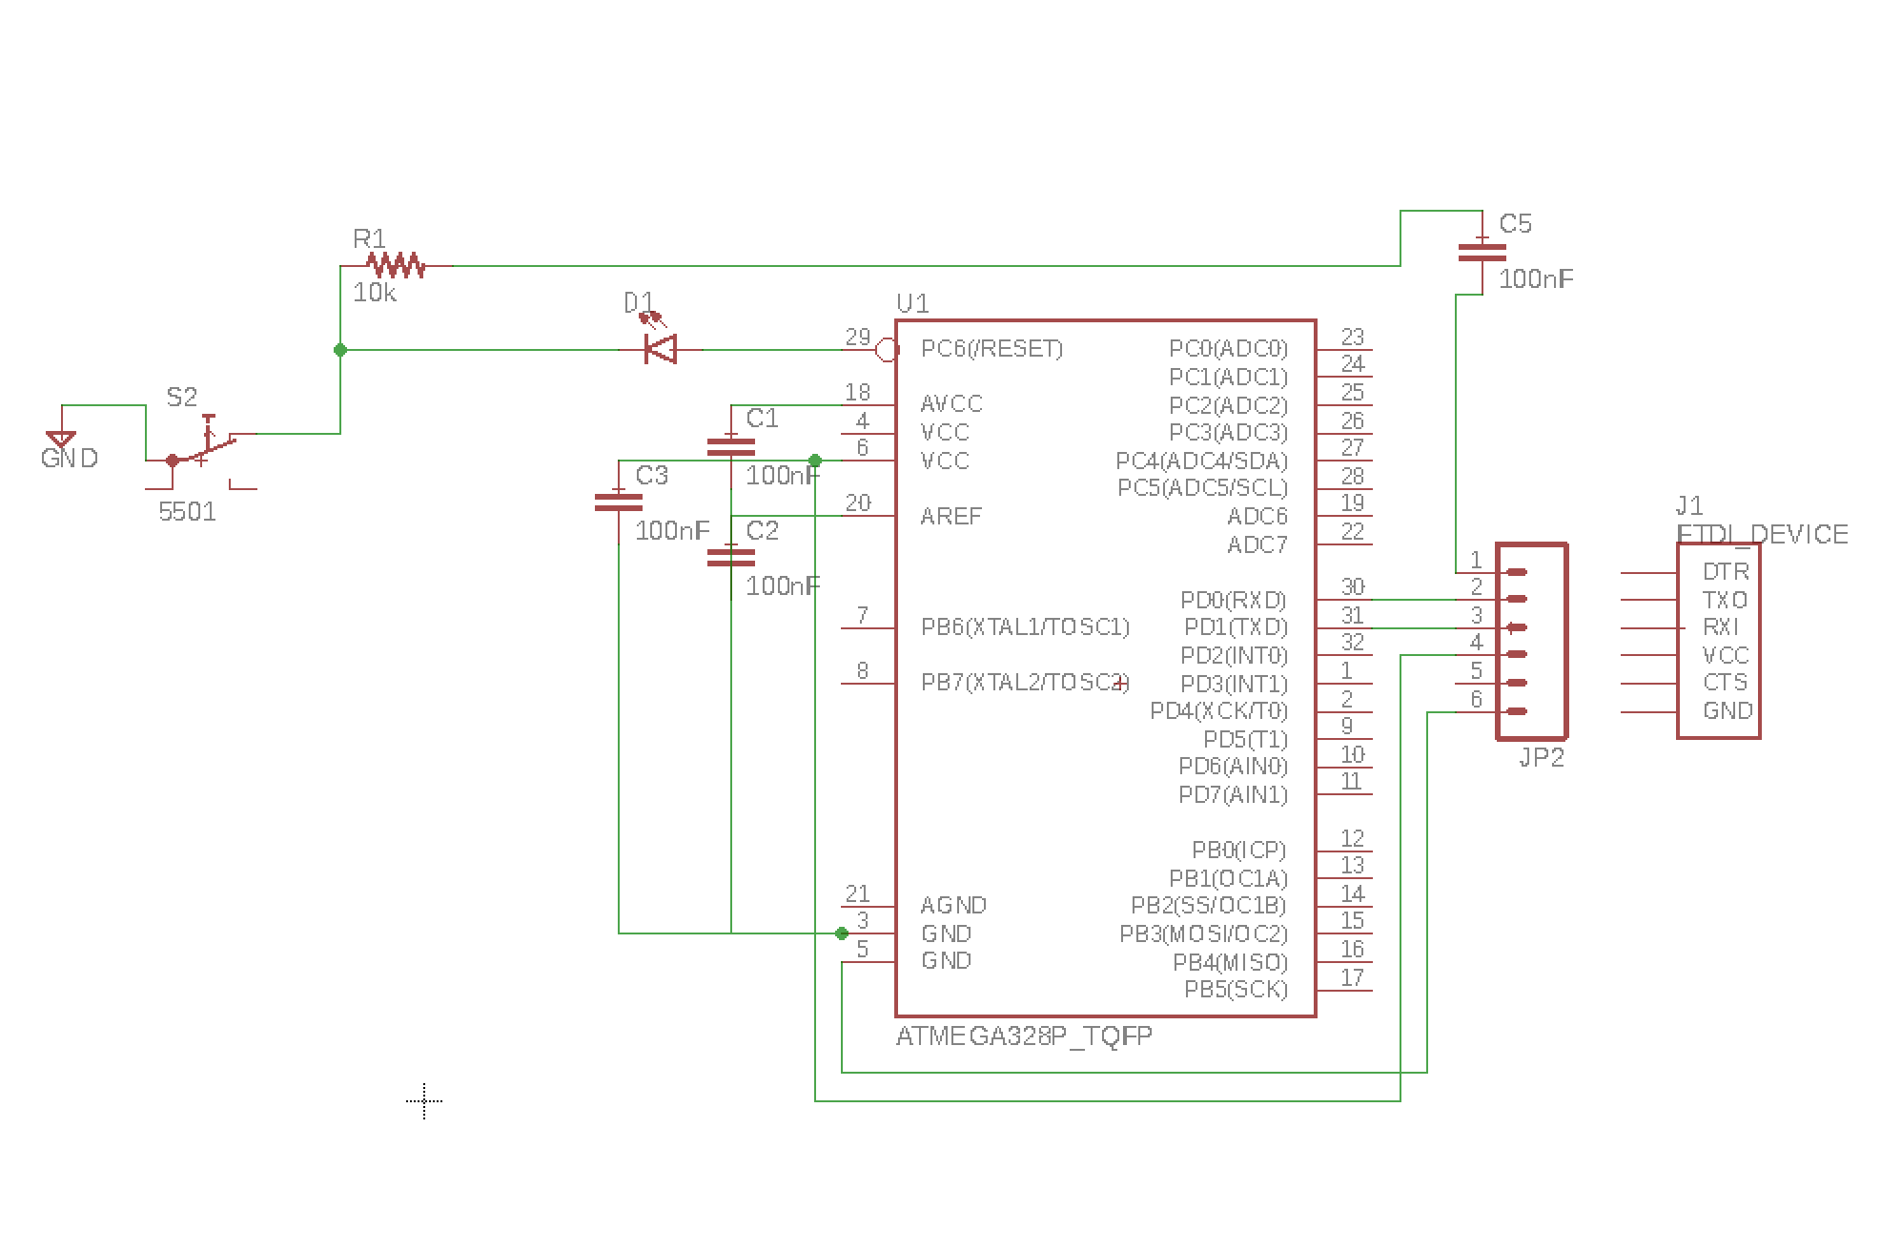
Decoupling MCU

Slide 4
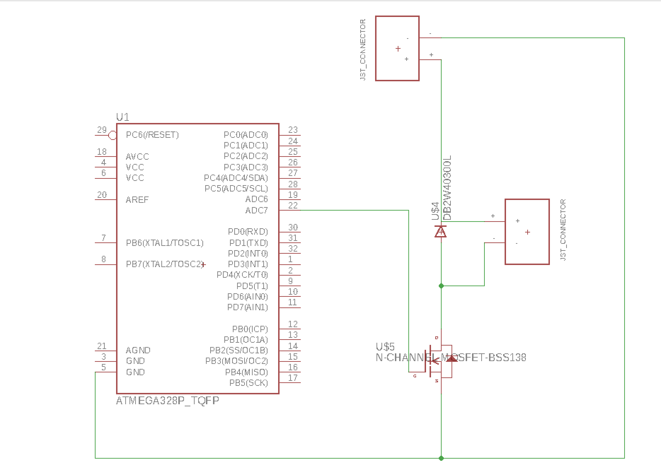
Motor Driver

Slide 5
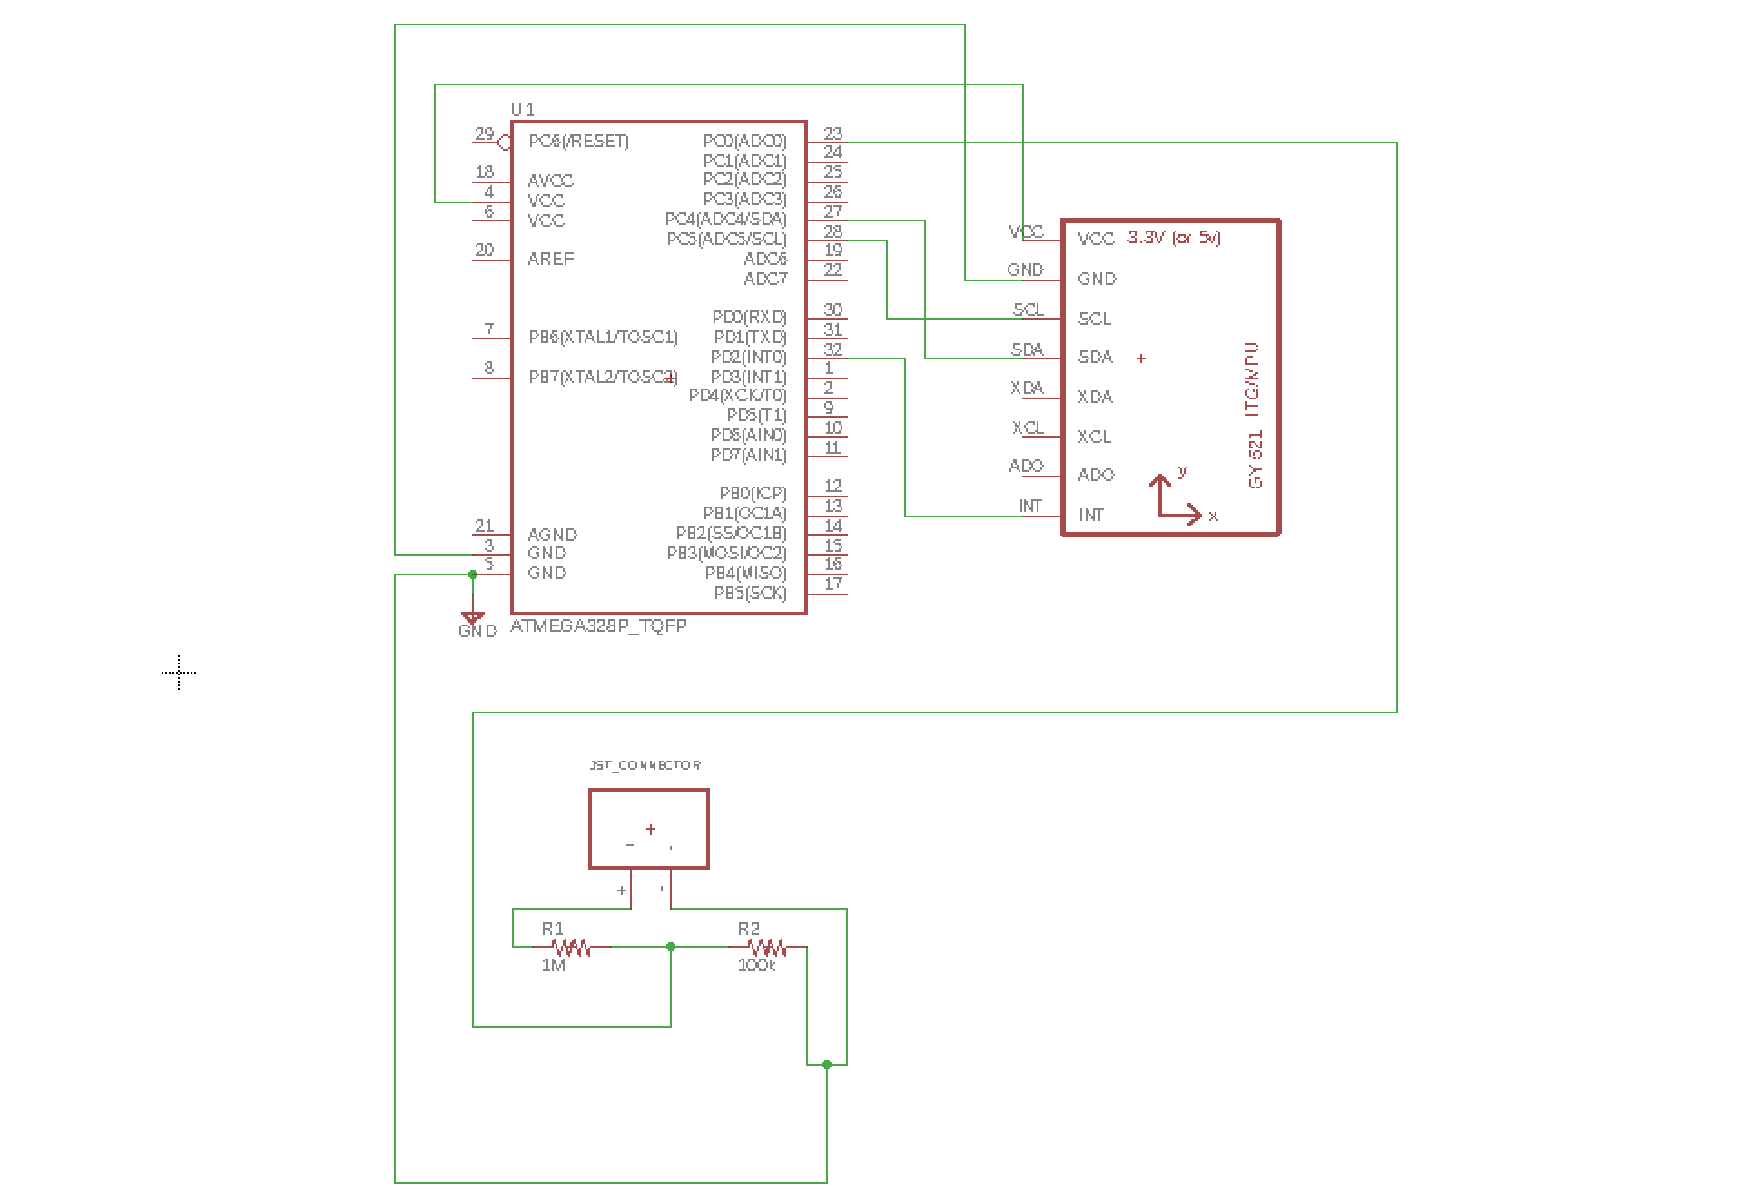
IMU to MCU and voltage divider

Slide 6
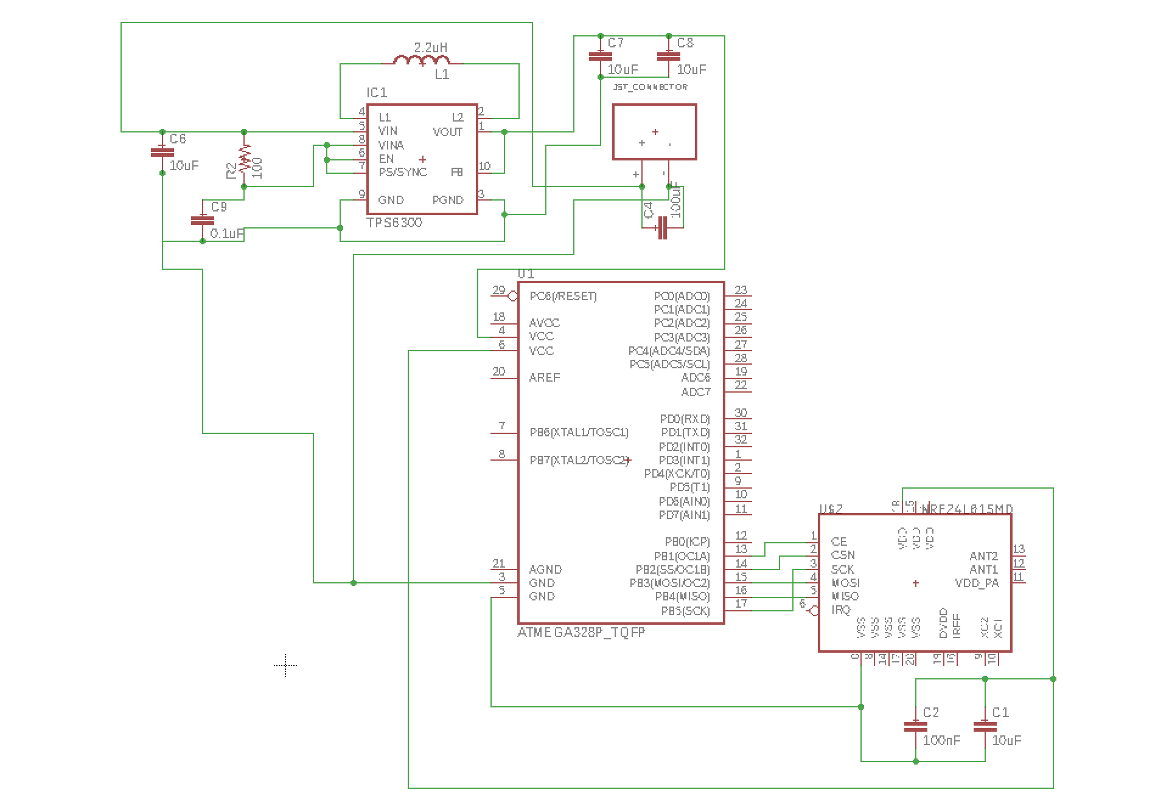
RF24 to MCU and buck boost converter

Slide 7
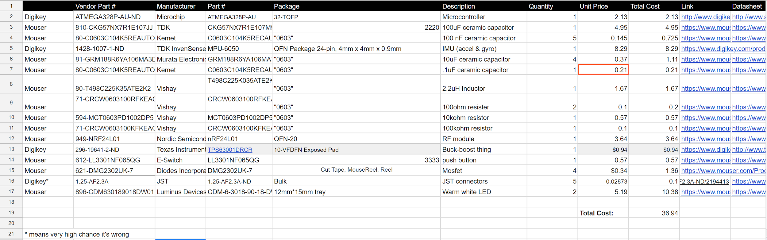
Bill of Materials
https://docs.google.com/spreadsheets/d/1XHGL43idXW7UUi7sieGBfkb_WzO-GkUvsEv8cnh8tEY/edit#gid=0

